Slide 1

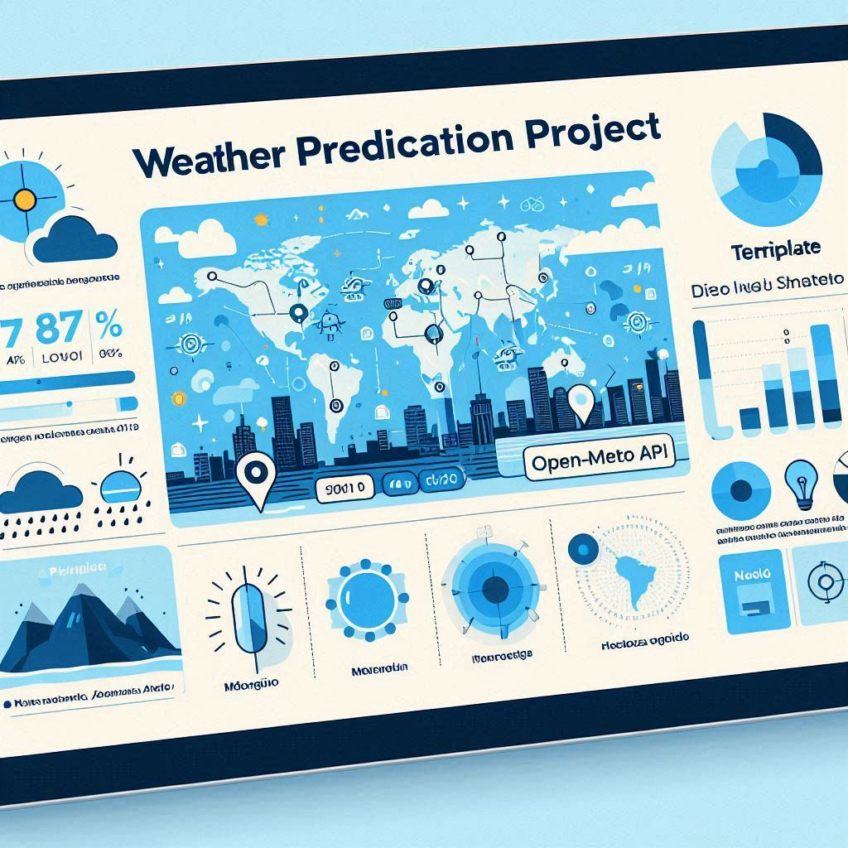
Weather prediction Project
Introduction
I have generated a predictive model that estimates the probability of Rain / Snow / Hail occurrence based on hourly historical weather data for Montreal, Quebec.
The dataset was generated using the public Open-Meteo API, which provides detailed hourly weather observations (Open-Meteo API Docs)
Notes:
Introducing the project name along with the responsible person overseeing its execution. This slide serves as the starting point, providing vital information about the project's identity and the key individual accountable for its success.

Slide 2
Weather prediction Project
Objective
The goal of this project is to develop a supervised Machine Learning classification model that estimates the hourly probability of rain / snow and hail occurrence using meteorological features such as temperature, humidity, wind, pressure, cloud cover, and precipitation.
The model is trained using a binary target label automatically derived from the weather_code field.
Weathe codes source: National Centers for Environmental Information
Notes:
Introducing the project name along with the responsible person overseeing its execution. This slide serves as the starting point, providing vital information about the project's identity and the key individual accountable for its success.

Slide 3
Weather prediction Project
Weather codes used – Source: National Centers for Environmental Information
Notes:
Introducing the project name along with the responsible person overseeing its execution. This slide serves as the starting point, providing vital information about the project's identity and the key individual accountable for its success.

Slide 4
Weather prediction Project
Data Description
Dataset: quebec_hourly_weather_2017_2024.csv
This dataset was generated with the OpenMeteo_Historical_DataV2.py script that queries the Open-Meteo historical weather API.
Selected hourly variables include
temperature_2m (air temperature)
precipitation_probability
precipitation
relative_humidity_2m
cloud_cover, cloud_cover_low, mid, high
pressure_msl, surface_pressure
Wind speed and direction (at multiple altitudes)
dew_point_2m, apparent_temperature, evapotranspiration, visibility, and others
Notes:
Introducing the project name along with the responsible person overseeing its execution. This slide serves as the starting point, providing vital information about the project's identity and the key individual accountable for its success.

Slide 5
Weather prediction Project
Feature Selection & Cleaning
Original dataset: Hourly weather data from Open-Meteo for Québec (2017–2024).
Removed columns:
precipitation_probability (due to missing values)
Other redundant features
Filtered records: Kept only rows where weather_code is not null
Notes:
Introducing the project name along with the responsible person overseeing its execution. This slide serves as the starting point, providing vital information about the project's identity and the key individual accountable for its success.

Slide 6
Weather prediction Project
Feature Engineering & Label Encoding
Target Label (Multi-label classification)
Created binary columns:
rain: 1 if weather_code in [61, 63, 65, 80, 81, 82]
snow: 1 if weather_code in [71, 73, 75, 77, 85, 86]
hail: 1 if weather_code in [96, 99]
Temporal Feature Generation
Extracted date time from date column to create:
hour, day, month, year
Notes:
Introducing the project name along with the responsible person overseeing its execution. This slide serves as the starting point, providing vital information about the project's identity and the key individual accountable for its success.

Slide 7
Weather prediction Project
Models Evaluated
Random Forest
Logistic Regression
Multi-label Strategy
Used MultiOutputClassifier from scikit-learn training one classifier per label (rain, snow, hail)
Hyperparameter Tuning
Performed using GridSearchCV
Notes:
Introducing the project name along with the responsible person overseeing its execution. This slide serves as the starting point, providing vital information about the project's identity and the key individual accountable for its success.

Slide 8
Weather prediction Project
Evaluation Metrics (Per Model & Label)
Metrics Used: F1-score and Recall for each label (rain, snow, hail)
Confusion Matrix
Random Forest achieved the best overall balance between recall and precision.
Notes:
Introducing the project name along with the responsible person overseeing its execution. This slide serves as the starting point, providing vital information about the project's identity and the key individual accountable for its success.

Slide 9
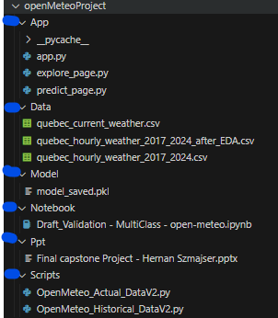
Weather prediction Project
Visual Studio – Folders and Files Structure
Notes:
Introducing the project name along with the responsible person overseeing its execution. This slide serves as the starting point, providing vital information about the project's identity and the key individual accountable for its success.

Slide 10
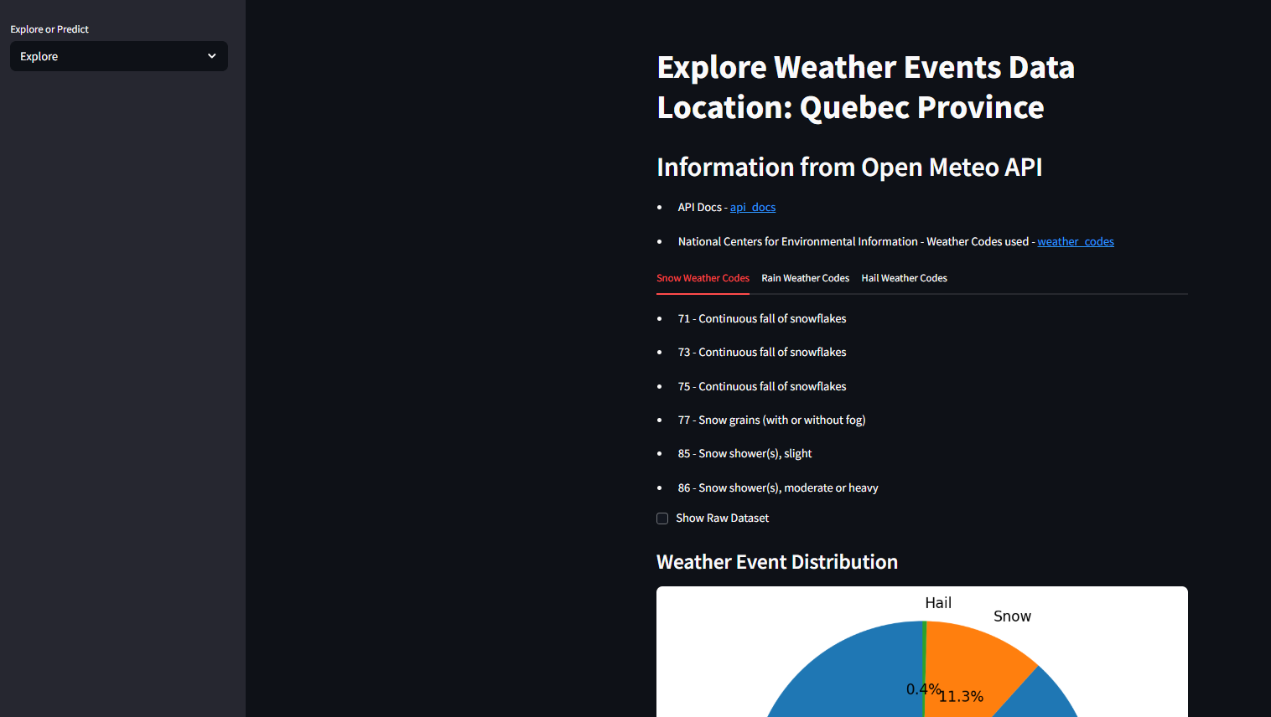
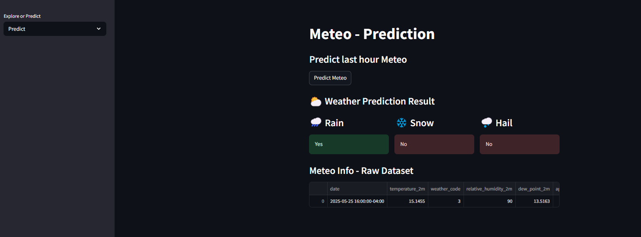
Weather prediction Project
Streamlit App – Demo
Notes:
Introducing the project name along with the responsible person overseeing its execution. This slide serves as the starting point, providing vital information about the project's identity and the key individual accountable for its success.

Slide 11
THE END!!
Notes:
En esta diapositiva, queremos expresar nuestro agradecimiento por su atención y participación. Esperamos que la información presentada haya sido útil y relevante. Si tienen alguna pregunta o necesitan más aclaraciones, no duden en preguntar. ¡Gracias nuevamente por su tiempo!

